Slide 1
TIES4911
Hannu Sirén

Slide 2
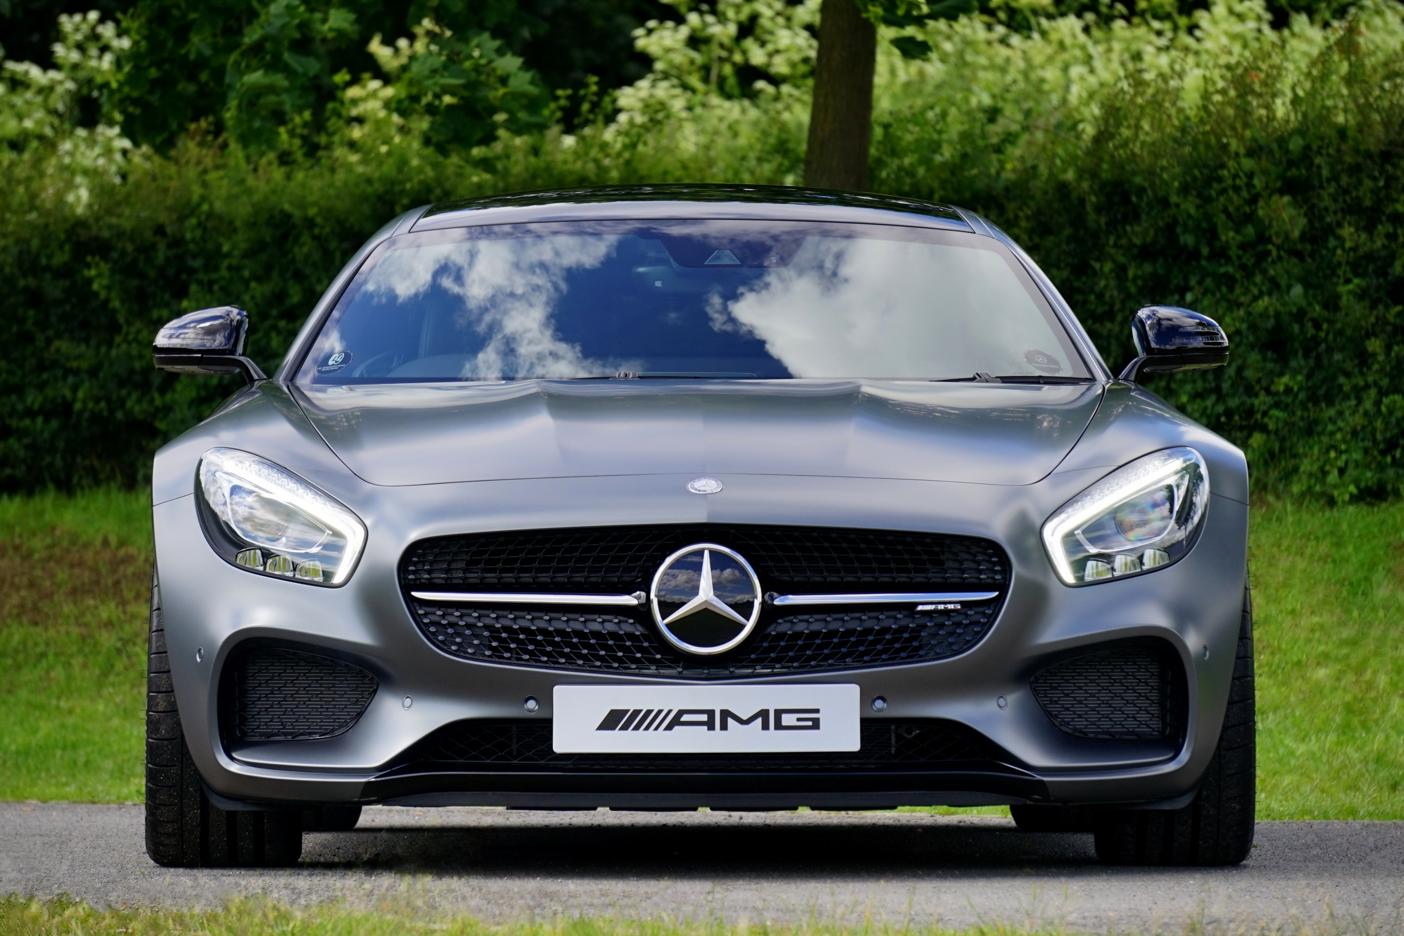
Darkflow:
No result
YOLO tiny:
Detect from D:\jyu\TIES4911 Deep-Learning for Cognitive Computing for devs\Task 4\images\car_front_AMG.jpeg
class : car , [x,y,w,h]=[1948,1594,2561,1637], Confidence = 0.2603861689567566
Elapsed time : 0.40183067321777344 secs

Slide 3
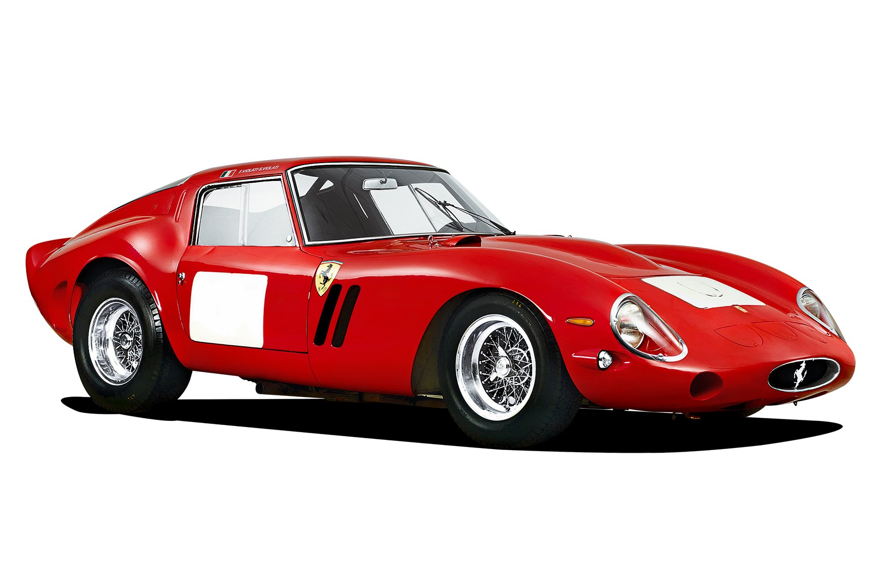
Darkflow:
No result
YOLO tiny:
Detect from D:\jyu\TIES4911 Deep-Learning for Cognitive Computing for devs\Task 4\images\car_side_Ferrari_250.jpg
class : car , [x,y,w,h]=[856,579,1181,532], Confidence = 0.43133506178855896
Elapsed time : 0.42305493354797363 secs

Slide 4
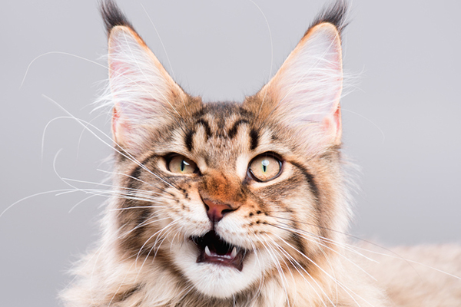
Darkflow:
[{"bottomright": {"x": 516, "y": 399}, "label": "cat", "topleft": {"x": 79, "y": 99}, "confidence": 0.81}]
YOLO tiny:
Detect from D:\jyu\TIES4911 Deep-Learning for Cognitive Computing for devs\Task 4\images\cat.jpg
Elapsed time : 0.32554173469543457 secs

Slide 5
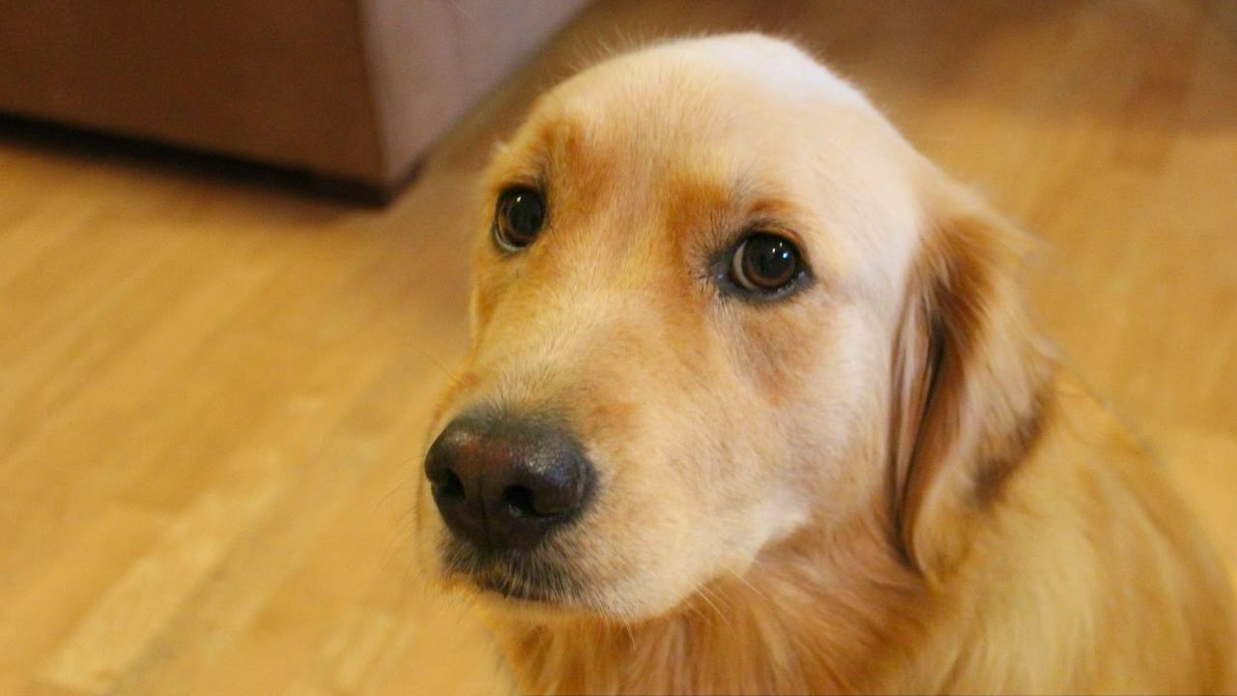
Darkflow:
No results
YOLO tiny:
Detect from D:\jyu\TIES4911 Deep-Learning for Cognitive Computing for devs\Task 4\images\dog.jpg
class : dog , [x,y,w,h]=[805,368,713,637], Confidence = 0.2295176088809967
Elapsed time : 0.3583219051361084 secs

Slide 6
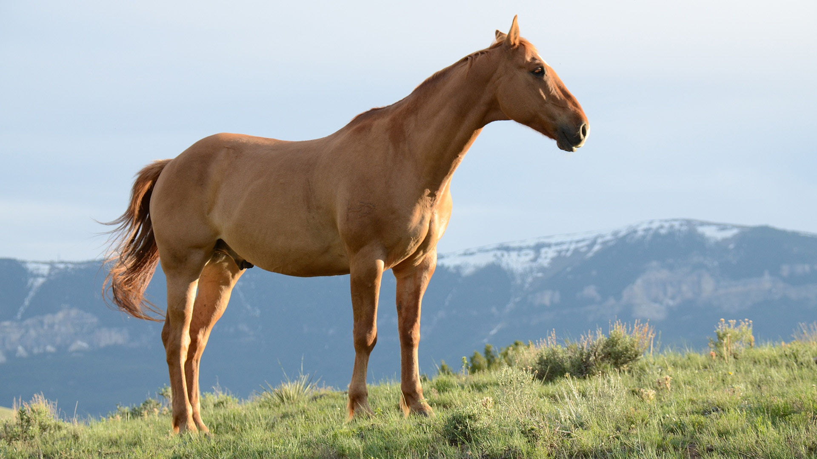
Darkflow:
[{"bottomright": {"x": 1232, "y": 1079}, "label": "horse", "topleft": {"x": 161, "y": 147}, "confidence": 0.78}]
YOLO tiny:
Detect from D:\jyu\TIES4911 Deep-Learning for Cognitive Computing for devs\Task 4\images\horse.jpeg
class : horse , [x,y,w,h]=[904,516,1001,818], Confidence = 0.27905964851379395
Elapsed time : 0.3575458526611328 secs

Slide 7
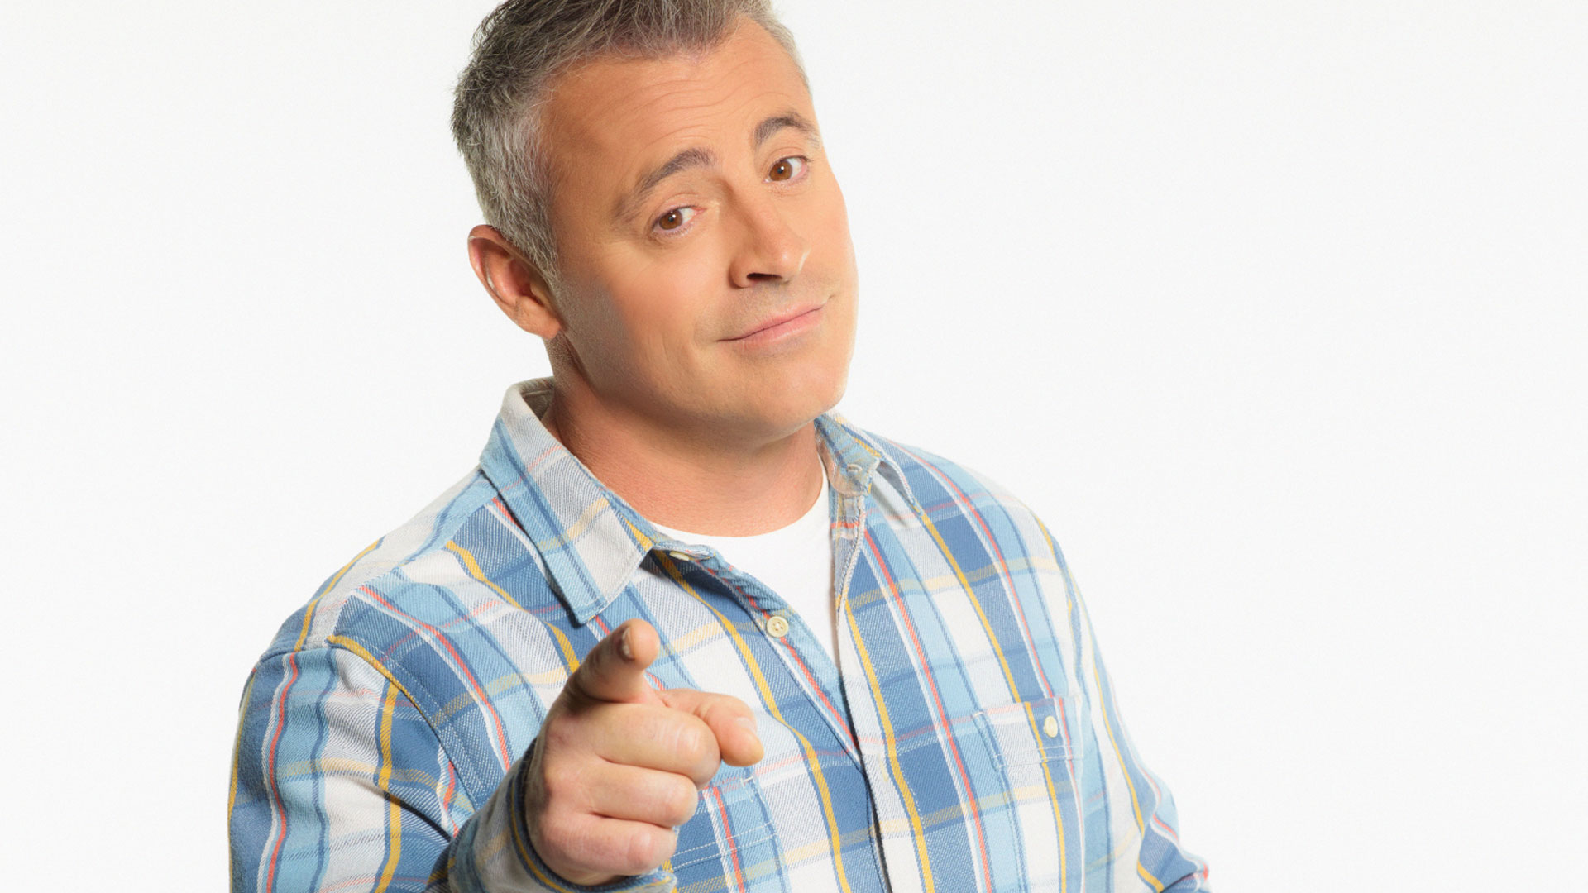
Darkflow:
No results
YOLO tiny:
Detect from D:\jyu\TIES4911 Deep-Learning for Cognitive Computing for devs\Task 4\images\man.jpg
class : person , [x,y,w,h]=[932,545,1323,909], Confidence = 0.43848803639411926
Elapsed time : 0.30571675300598145 secs

Slide 8
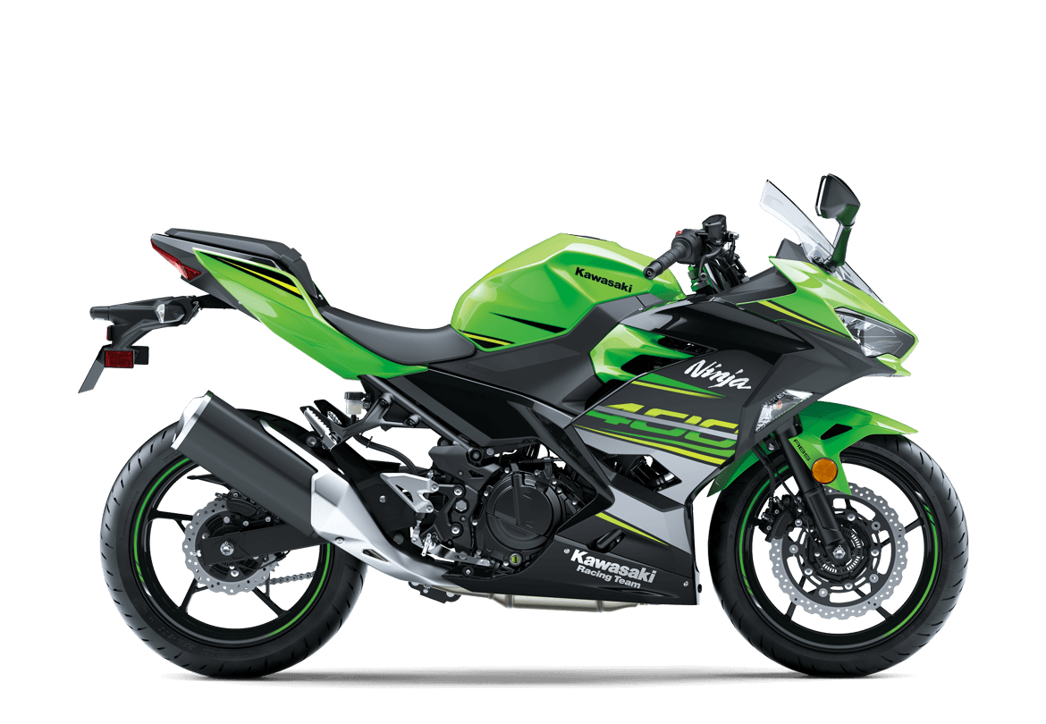
Darkflow:
[{"bottomright": {"x": 1169, "y": 768}, "label": "motorbike", "topleft": {"x": 134, "y": 170}, "confidence": 0.87}]
YOLO tiny:
Detect from D:\jyu\TIES4911 Deep-Learning for Cognitive Computing for devs\Task 4\images\motorcycle_kawasaki.jpg
class : motorbike , [x,y,w,h]=[588,484,736,511], Confidence = 0.29996293783187866
Elapsed time : 0.301027774810791 secs

Slide 9
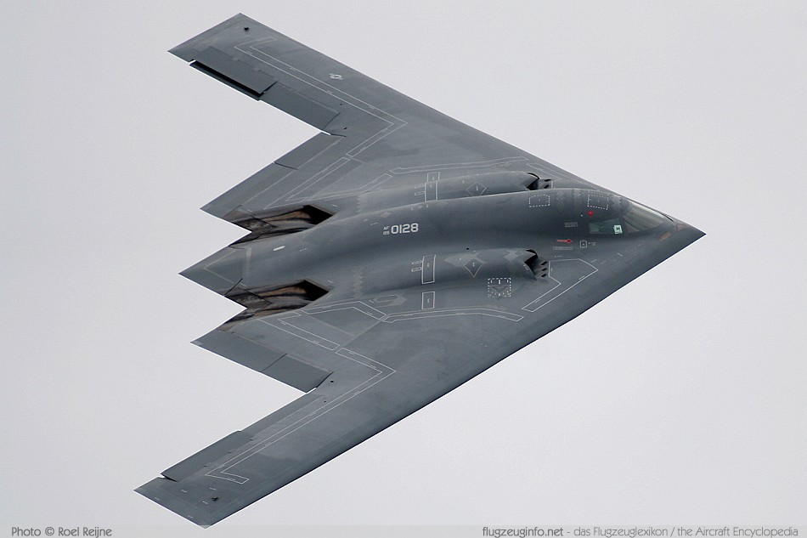
Darkflow:
No results
YOLO tiny:
Detect from D:\jyu\TIES4911 Deep-Learning for Cognitive Computing for devs\Task 4\images\plane_b2.jpg
class : aeroplane , [x,y,w,h]=[489,315,589,453], Confidence = 0.22578124701976776
Elapsed time : 0.3120431900024414 secs

Slide 10
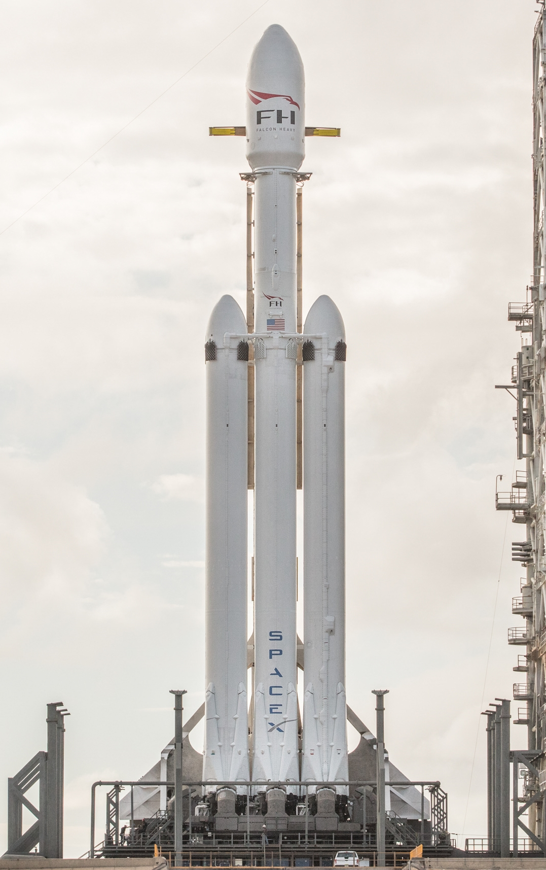
Darkflow:
No results
YOLO tiny:
Detect from D:\jyu\TIES4911 Deep-Learning for Cognitive Computing for devs\Task 4\images\Rocket_Falcon_Heavy.jpg
Elapsed time : 0.35497283935546875 secs

Slide 11
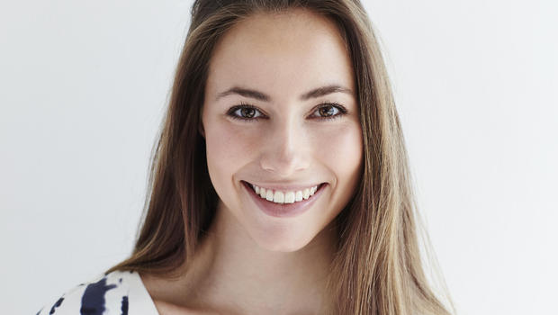
Darkflow:
No results
YOLO tiny:
Detect from D:\jyu\TIES4911 Deep-Learning for Cognitive Computing for devs\Task 4\images\woman.jpg
class : person , [x,y,w,h]=[304,177,432,306], Confidence = 0.46166548132896423
Elapsed time : 0.30002641677856445 secs

